Slide 1
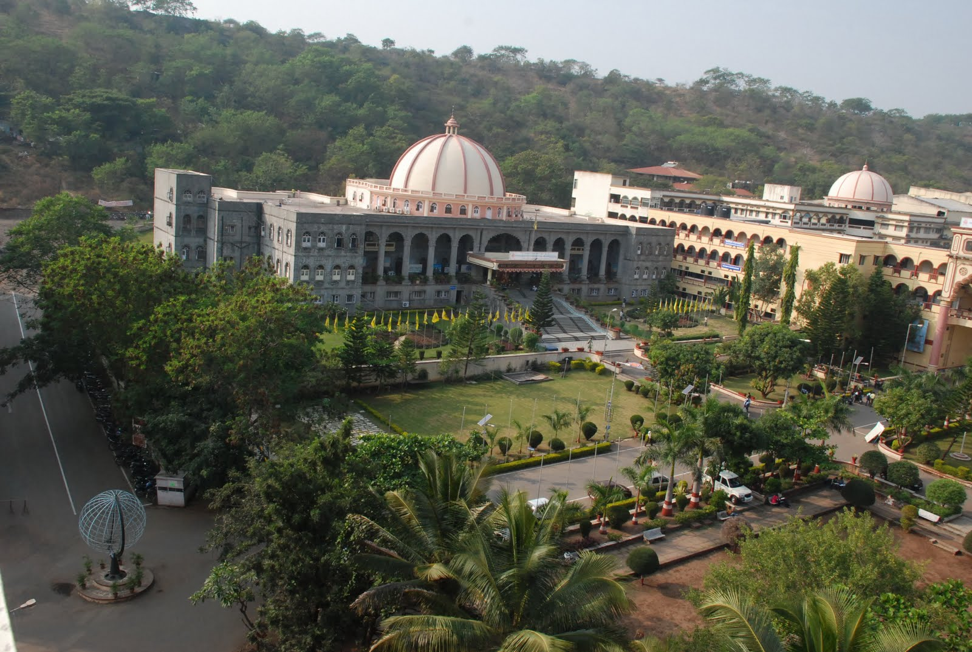
MAEER’s MIT Pune

Slide 2
Rock falls in `a’ā flows of Deccan Trap Basalts: Case studies from Western Maharashtra, India
R. A. Joshi*, L. K. Kshirsagar, P. B. Jadhav, Amey Dahsputre
MAEER’s
Maharashtra Institute of Technology,
Pune-411038
*Corresponding Author:
(* rahul.joshi@mitpune.edu.in / rajsarahjoshi@gmail.com)
(M):+919834241171, (O):+912030273498,
(F): +912025442770
Presented by Dr. R. A. Joshi
@EGCON-2018, Hyderabad

Slide 3
Outline of the Presentation
Introduction
Geology of the Area
Methodology
Discussion
Conclusion
References

Slide 4
Introduction
Infrastructural development required widening of roads in Western Maharashtra
Leading to modification of natural and cut slopes
These roads are passing through `a’ā and pahoehoe flows of Deccan Trap Basalt (DTB).
The `a’ā flows are generally present at relatively higher elevation i.e. above >700m msl,(Godbole et al, 1996) where the problem of rock fall is more serious.
Present study is carried out along Sinhagad Fort, Dive Ghat and Khambataki ghat section nearby Pune city

Slide 5
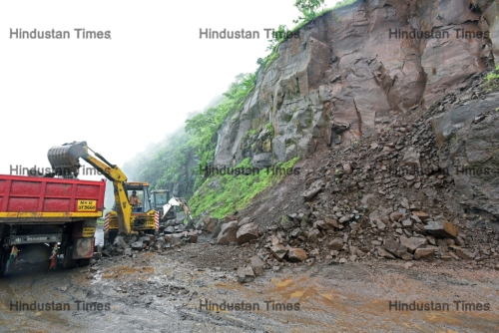
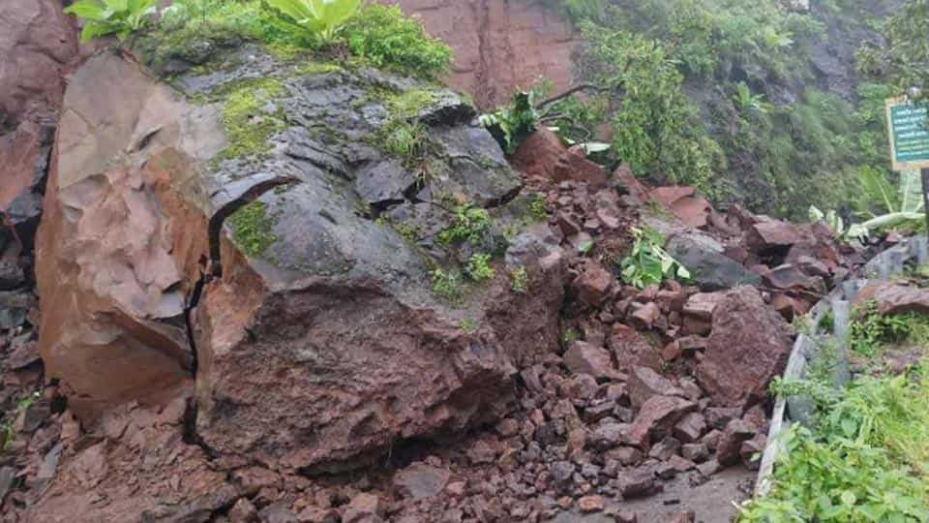
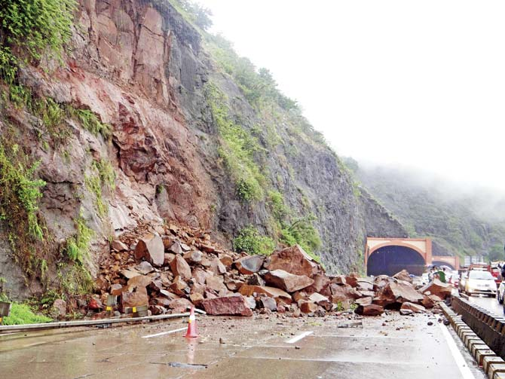
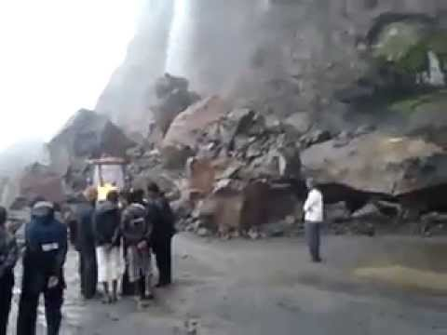
Introduction
Sinhagad Ghat, July 2017
Sinhagad Ghat, July 2018
Pune –Mumbai Express way, June 2015
Malshej Ghat, July 2018

Slide 6
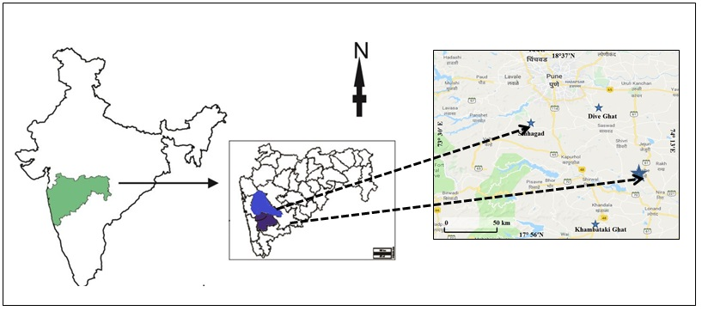
Figure 1: Location map of Sinhagad, Dive and Khambataki ghat sections

Slide 7
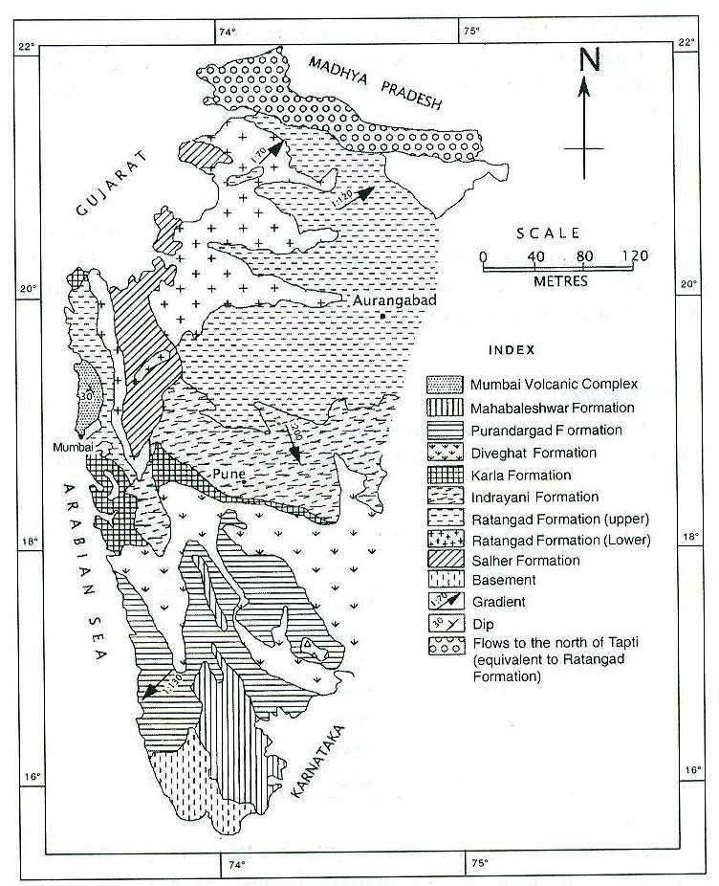
Map showing Lithostratigraphic Succession of Deccan Trap Supergroup (Godbole et al, 1996)
1
2
3
Locality Index
Pune city and adjoining area
Sinhagad Ghat
Dive Ghat
Khambataki Ghat
4

Slide 8
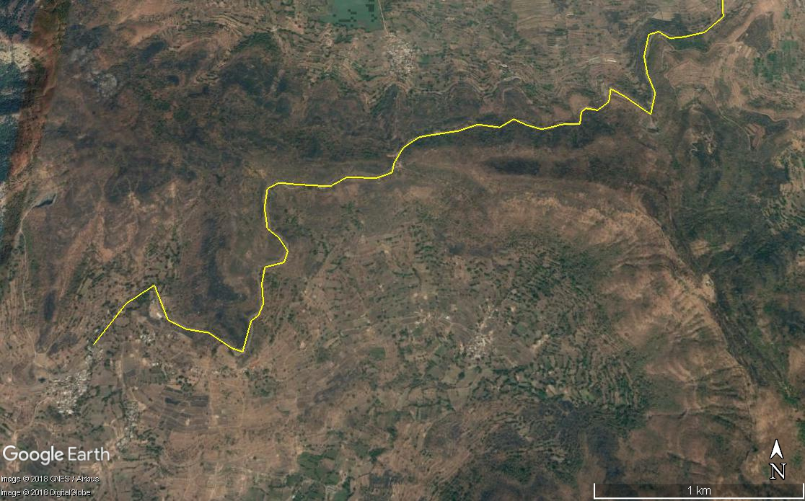
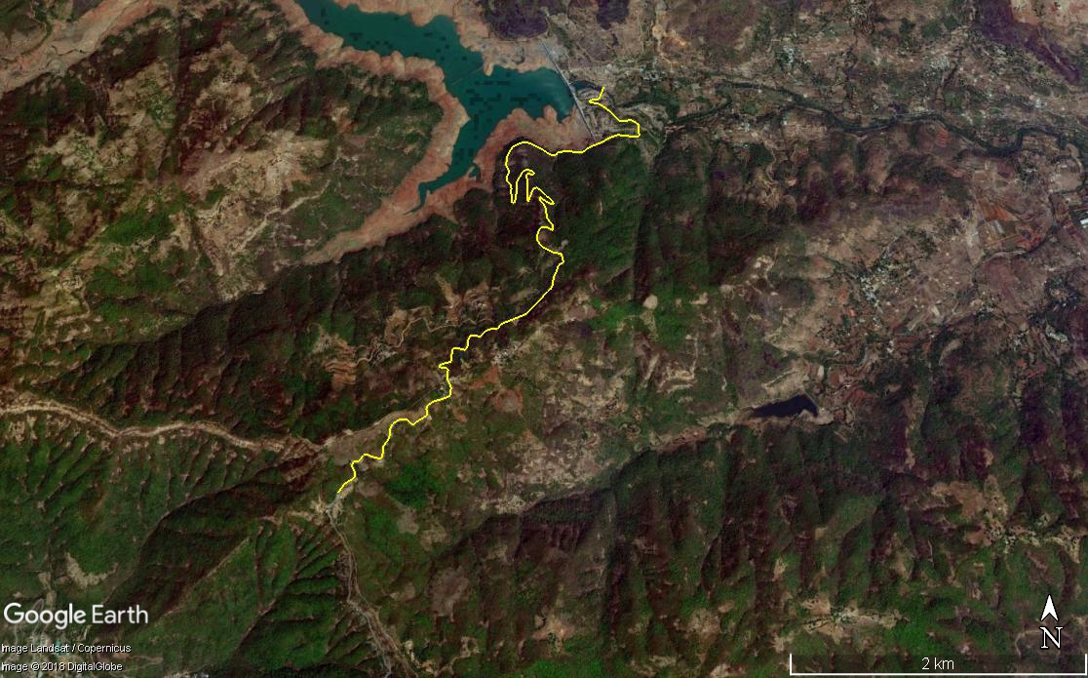
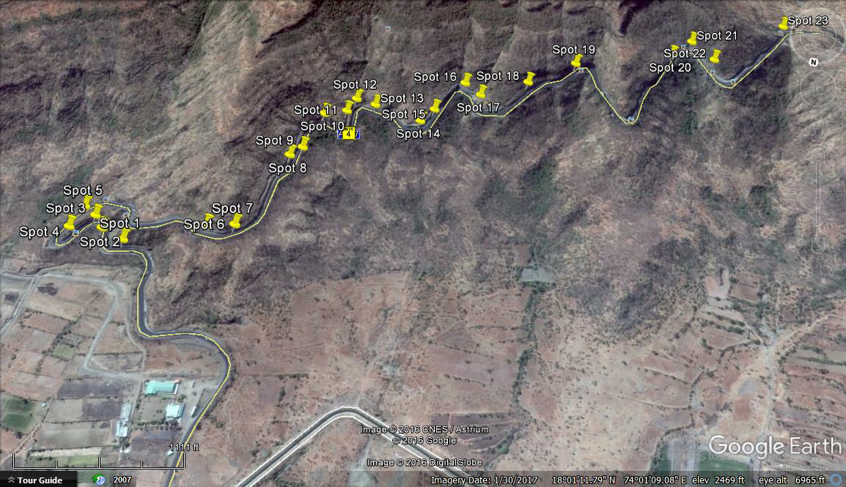
Google Images of Various Ghats
Pune City
Khambataki Ghat
Sinhagad Ghat
Dive Ghat
To Pune City
Pune City

Slide 9
Table 1:-Details of ghat sections studied
No. | Location | Coordinates | Elevation in m (MSL) | Length of Ghat (m) | Number of `a’ā Basalt flows studied
1 | Sinhgad Fort Ghat | 18º21'N /73º45'E | 650 to 1300 | 8700 | 16
2 | Dive Ghat | 18º24'N / 73º59'E | 580 to 980 | 4800 | 07
3 | Khambataki Ghat | 17°N/74°E | 700 to 954 | 7000 | 05

Slide 10
Methodology
Study of Basalt Flow Morphology
Exploring Relationship of different components of Flows and cut slopes of the roads
Role of Joints on the stability of the road sections

Slide 11
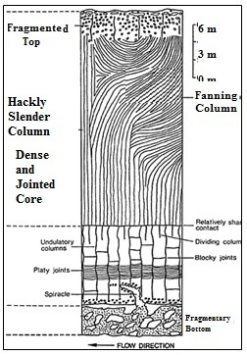
Study of Basalt Flow Morphology
Use of Standard Hawaii Terminology to describe the basalt flows in DTB
Typical Flow Morphology of `A`Ā flows, (modified after Lyle, 2000)

Slide 12
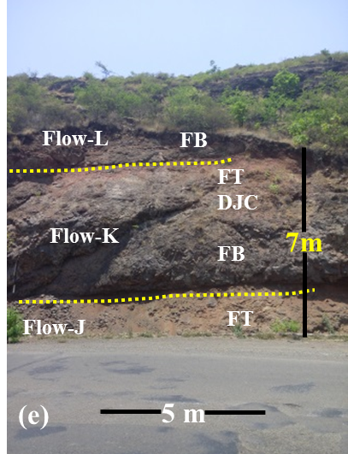
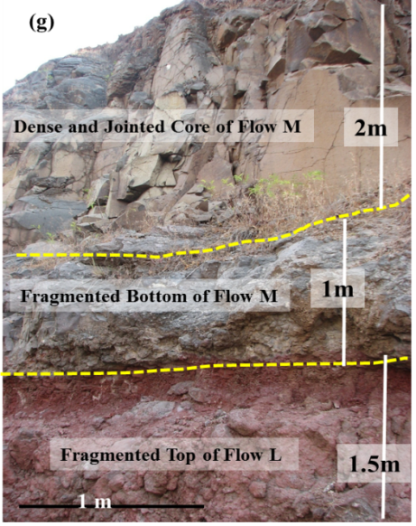
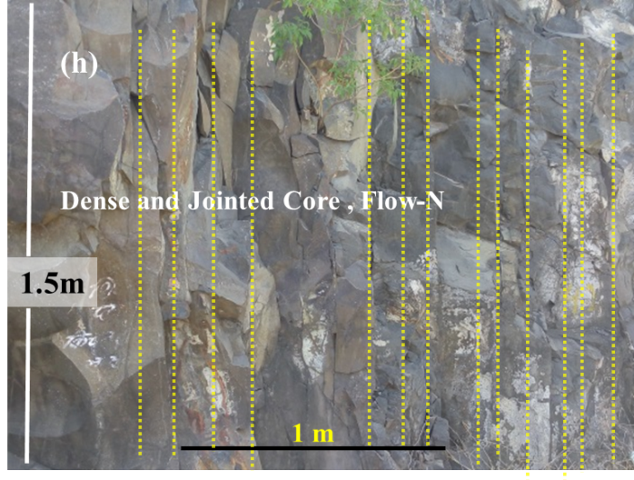
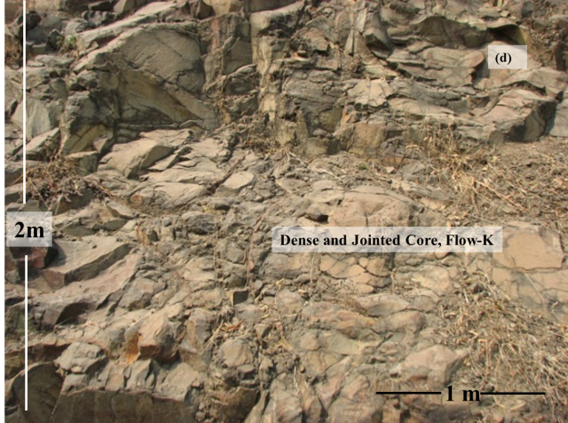
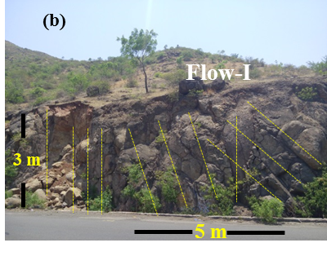
Study of Flow Morphology from Type Section –à`ā Flows, Dive Ghat, SE Pune
Dense and Jointed Core of Flow-N
Dense and Jointed Core, fragmented bottom of Flow-M, and Fragmented top of Flow-L
Dense and Jointed Core of Flow-K, Fragmented top of Flow-J and bottom of Flow- L
Dense and Jointed Core of Flow-I
Dense and Jointed Core of Flow-K
Notes:
In these aa flow exposures, different style of jointing, differing thickness of FT/FB and DJC zone within the flow.

Slide 13
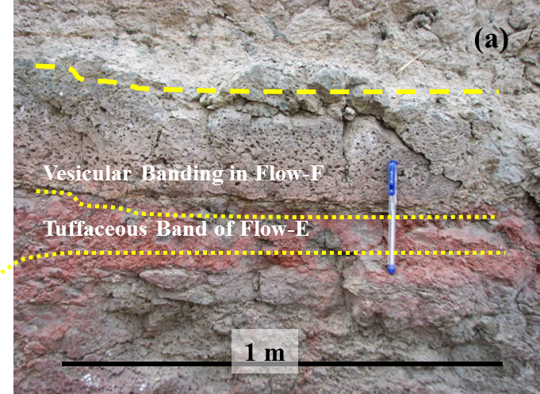
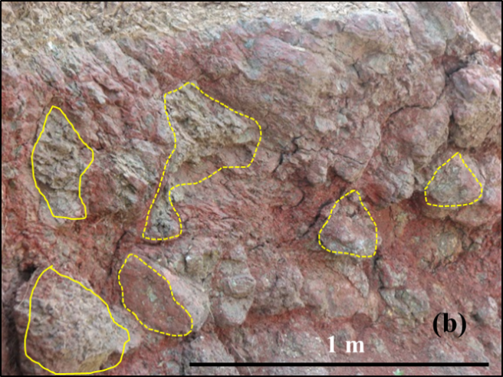
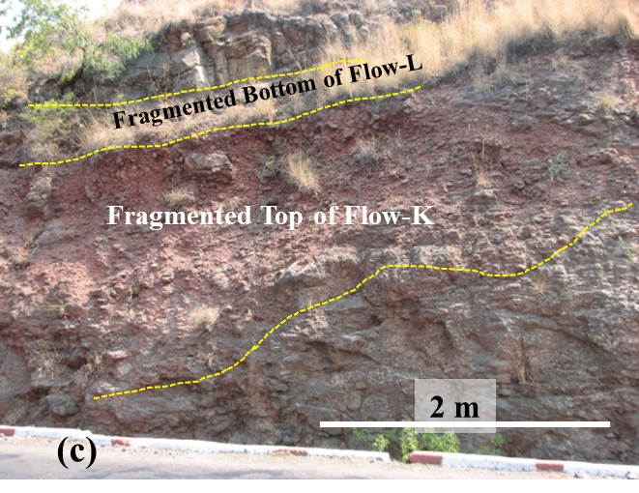
Study of Flow Morphology from Type Section –Interflow Horizons,
Dive Ghat, Near Pune
Pāhoehoe Flow group ‘F’ showing vesicular banding underlain by thin tuffaceous band,
Exposure of volcanic breccia with fragments of varying size
Thick exposure of interflow horizon of Flow K
Notes:
Key aspects of the morphology of flows are as follows:
Varying dimensions of flow lobes in case of pāhoehoe flows
The varying thickness of zones of flow (Fragmented) Top and Bottom in case of à`ā flow.
Curviplanar joint systems
Variation in an attitude of joints along the exposed section of the flow.
Variation in lithology within a flow e.g. amygdular, aphinitic and vesicular, volcanic breccia, tuffaceous bands
Varying intensities of weathering for different parts as well as exposures of flow.
Flows are heterogeneous at outcrop scale and show variation in lateral and vertical direction on account of vesicularity, jointing.

Slide 14
AA Basalt Flow Morphology
Fragmented Top (FT) :
It has a thickness of about 2-4 m. This zone occupies 10 to 15% of the total thickness of the flow and shows reddish brown top with tuffaceous layers and rolled over fragments with greyish, highly zeolitised matrix. It composes upto 10% of the total volume of the flow.
Dense and Jointed Core:
Below FT, a dense and jointed solid lava core exists. This zone has massive and dense compact basalt with occasional amygdularity. Presence of curviplanar joints occurring in one or two sets is the most important feature of this zone. This portion occupies 80% of the total volume of the lava flow.
Fragmented Bottom (FB):
This zone is underlain by a thin portion (upto 15%) of rubble forming ‘Fragmented Bottom (FB)’. It composes upto 10% of the total volume of the flow.

Slide 15
Relationship of different components of flows and cut sections of the roads
(A) Fragmented Top developing gentle slope and low height cliff in flow 6, Sinhagad ghat
Figure-(B) Fragmented Top developing gentle slope in flow 15, Sinhagad ghat

Slide 16
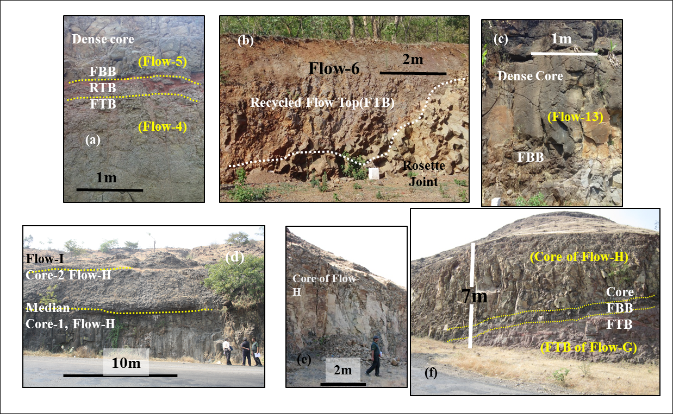
Variation in Engineering Properties of à`ā Flow
Fragmented Top
Sinhagad Ghat, Near Pune
Dive Ghat, Near Pune
Shindavane Ghat, Near Pune
Notes:
Variation in Engineering Properties of à`ā Flow

Slide 17
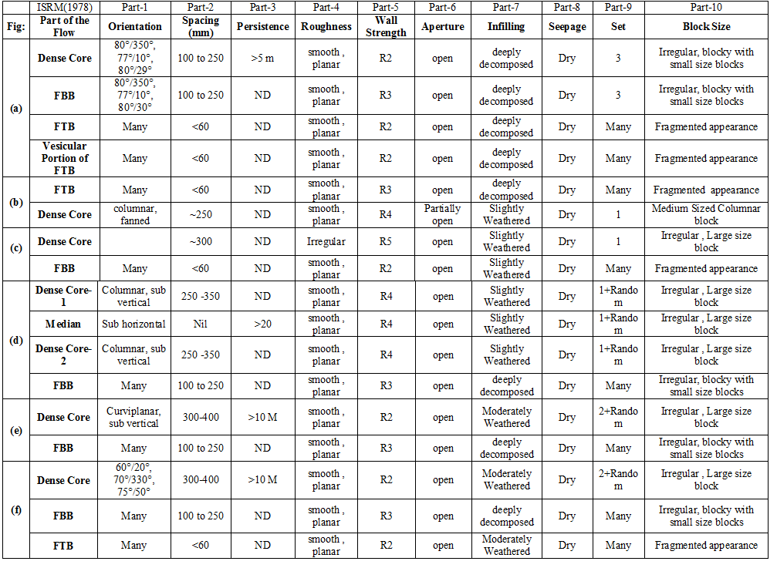
Variation in Engineering Properties of à`ā Flow
Notes:
Various engineering properties of different zones of à`ā flow is summarized as follows:
FTB, FBB have similar lithologies and may show similar engineering properties (partly discussed under interflow horizon)
Dense and jointed core (DJC) has more subvertical; columnar joints with varying attitude. In between, two tiers of columnar joints, a subhorizontal median may be present.
Spacing of the joints varied from closely spaced to wide i.e. 60 to 400 mm.
Joints may have medium to low persistence i.e. from ~1 m to 10m.
Along the joints, wall strength is low i.e. R2-R3.
Joints may have rough to smooth planar roughness,
Joints have aperture from tight to open i.e. 0.25 to 2.5 mm.
Infilling show variation from slightly weathered (II) to Deeply weathered(V)
DJC has at least two sets of joints with few random joints,
Dense core show small to large sized blocks.
This indicates that outcrops of DJC are controlled by properties of joints. In general, DJC has rock with high strength but it can be affected by grade of weathering along the joint or within the core as well as other joint parameters. Spheroidal weathering is developed with rinds having relatively high degree of weathering than core.

Slide 18
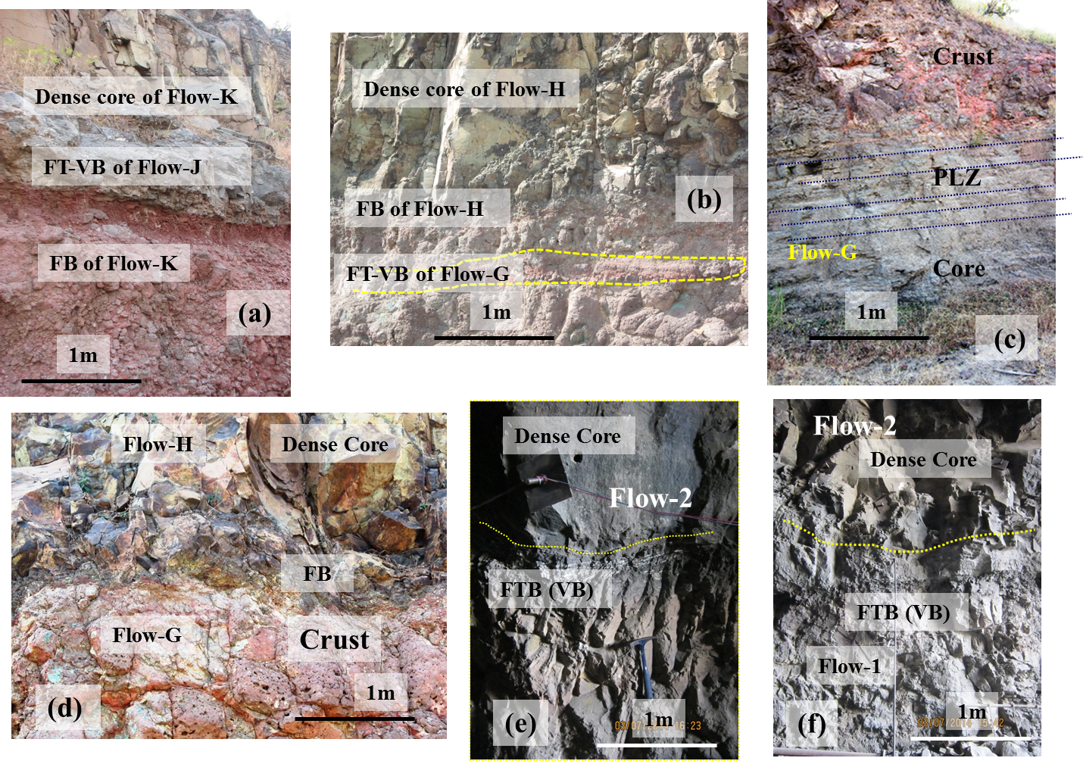
Variation in Engineering Properties of Interflow Horizons
Dive Ghat, Near Pune
Shindavane Ghat, Near Pune
Marguthi Tunnel, NE Karnataka
Notes:
Variation in Engineering Properties of Interflow Horizons

Slide 19
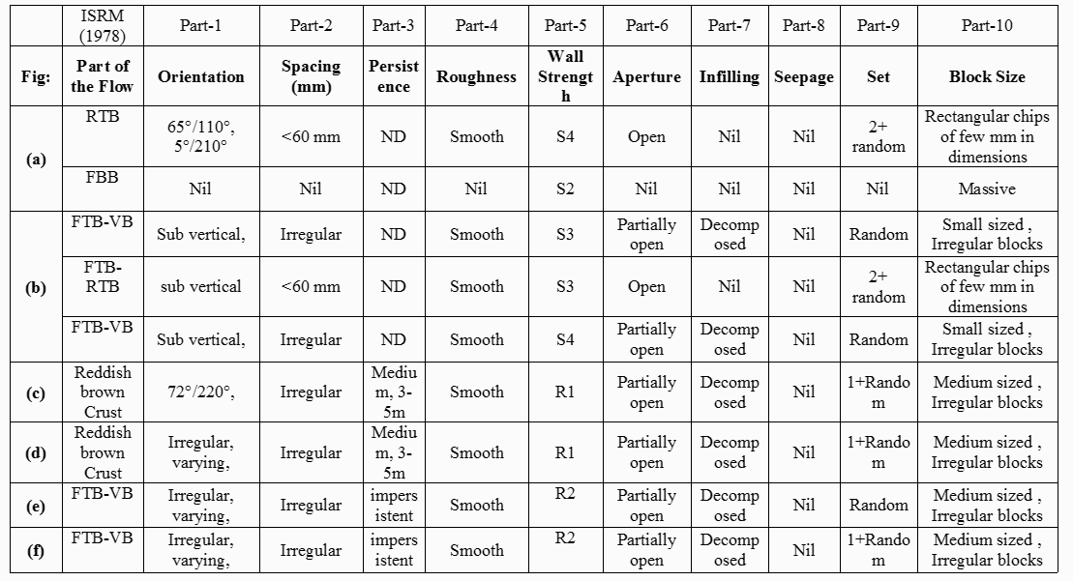
Variation in Engineering Properties of Interflow Horizons
Notes:
Interflow horizons show varying lithology such as tuff and or breccia. Brecciated portions often show basaltic fragments surrounded by varying types of lava matrix. Tuff / Breccia have low strength than main rock body and may show presence of impersistent joints.
Brecciated portions may not have joints but, tuffaceous portions show very closely spaced (upto 60 mm) platy joints with varying properties (Kshirsagar,1982).
In the outcrop section, persistence cannot be determined and along the joints, wall strength is low i.e. S2 to S4. Joints may have smooth planar roughness with open aperture i.e. ~ 0.25 mm.
Small to very small block (>30 joint/m³) with rectangular, fragmented appearance. In general, interflow horizons have a rock with low strength and it can be further affected by grade of surficial weathering.
Strength of the rock from interflow zones is higher when freshly excavated or cored. However, upon exposure to atmosphere, the rock crumbles in a few days losing its strength.

Slide 20
Case Study-I Sinhagad Ghat

Slide 21
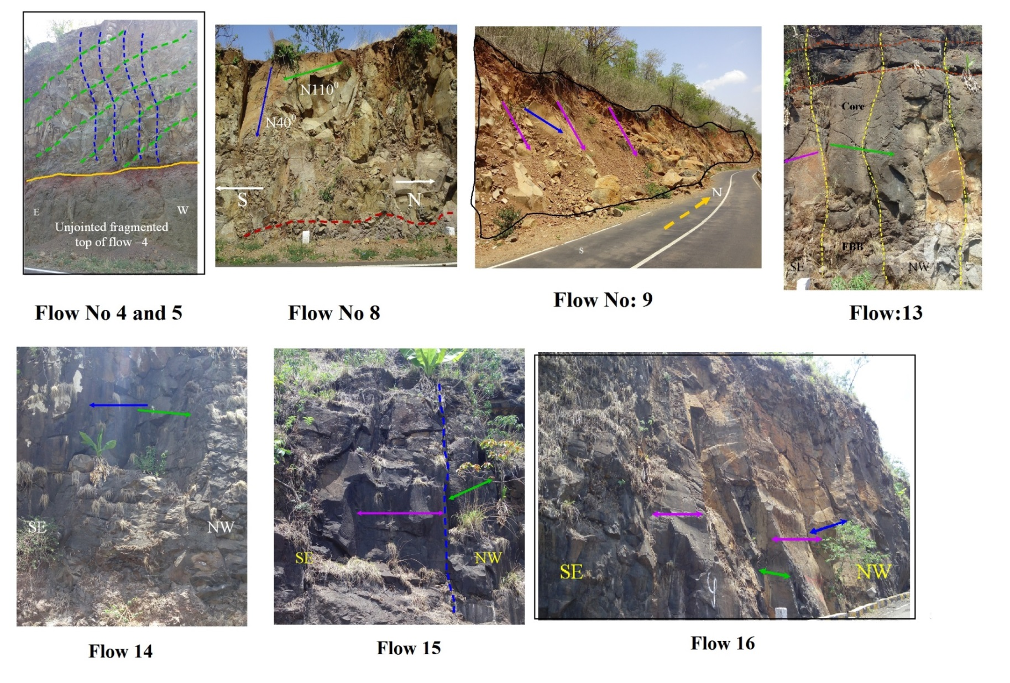
Different Basalt Flows of Sinhagad Ghat
Notes:
Flow 4 and 5:Moderately weathered vesicular and clinkery fragments occupy FB with 10 cm to 15 cm zone at the base followed by jointed and greyish black, fine grained, non-vesicular, aphinitic dense core with thickness of about 40 m. FT is fragmented with 2 meter thickness and has a sharp contact with overlying Flow -6. FT consists of 40-50 cm thick red horizon. FT is moderately to highly weathered. Figure shows exposure of Flow-5 at first hair pin bend of ghat (Ch. 2230 m) with intersection of three joints as 74°/N351°, 82°/N17° and 81°/N283°.
Flow 8:FB is brown and vesicular with a sharp, undulatory contact with Flow-7 and has a thickness of about 1m. Dense and jointed core is aphinitic, non-vesicular. Towards the top portion, it shows elongated vesicles without any infillings. FT consists of red horizon with thickness upto 25 -30 cm. Red horizon shows closely spaced jointing and is highly weathered. Figure shows outcrop of dense core of Flow-8 at Ch. 4900m. Outcrop shows intersection of joints with 75°/N110°, 84°/N24°, 76°/N145°
Flow 9:FB with 50-70 cm thickness consists of elongated vesicles. Middle portion is dense and jointed with a thickness of about 7.5 m. The top portion of this zone is vesicular and is moderately weathered. It is overlain by red horizon with 20-25 cm thickness. Figure shows exposure near Ch. 5300 m from dense core of this flow. Intersection of joints with 71°/N40°, 80°/330° and 80°/N63° forms a wedge.
Flow 13: FB is vesicular and slightly weathered with a thickness of about 1m. The middle part of the flow is dark grey, fine grained and becomes vesicular towards the top. FT is marked by a red horizon with tuffaceous band of 10-15 cm thickness. FT shows sharp contact with FB of Flow-14. Figure 7‑13 (a) shows exposure of dense core portion of Flow-13 at 8300 m with fragmented bottom visible where joints are curviplanar and subvertical with 80°/N150°. The FB is thin with less than 600 mm and fragmented.
Flow 14:FB consists of spherical vesicles filled with zeolites. Middle portion has a thickness of 25-27 m. It is non-vesicular in the lower and central portion and becomes vesicular with large, irregular and empty vesicles in the top portion. Top of the flow is marked with red horizon of 20-30cm thickness with red tuffaceous band having sharp contact with upper flow. Figure shows exposure of dense and jointed core portion of this flow.
Flow No.15: FB is 50-70 cm thick with oval vesicles filled with zeolites. Dense core is jointed and has a thickness of about 24 m. Joints are subvertical and columnar. FT has a thickness of 2-3 m and shows fragments of various sizes from few mm to few cm. Figure shows exposure (near Ch. 8800) m of columnar jointed dense core of this flow. joints 73°/N146° and 68°/N77° and 82°/N18°
Flow No. 16: FB is greyish and consists of elongated filled vesicles. The middle part of the flow has a thickness of 19-21 m and is grey in colour, fine grained and dense with large grains of felspars. This portion shows curviplanar, columnar jointing. The FT top has red tuffaceous band of 10-15 cm. This portion has a gradational contact with dense core of the flow. In Figure exposure of columnar jointed compact basalt from dense jointed core portion of this flow is observed. Joints have orientation of 75°/N134°, 70°/N145°, 78°/N21° .

Slide 22
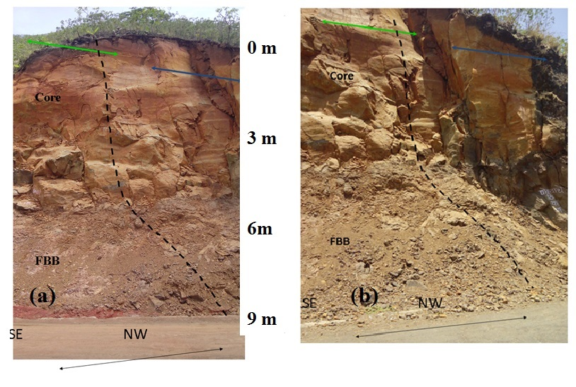
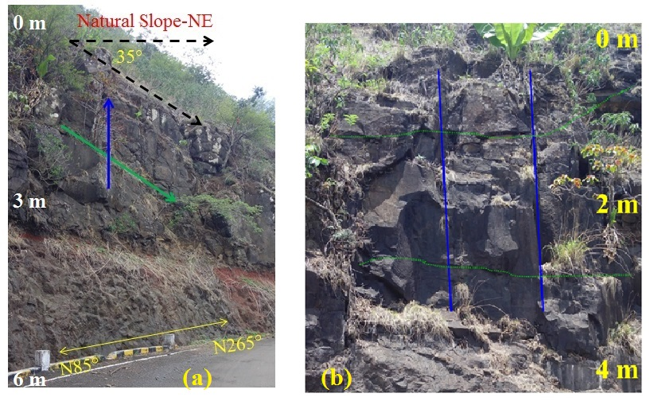
Flow:17
Different Basalt Flows of Sinhagad Ghat
Flow:19 and 20
Notes:
Flow No. 17: The FB has a thickness of 2-2.5 m and consists of few filled vesicles. Dense core has a thickness of about 35m showing curviplanar joints. Top 2-3 m of this portion shows stretched vesicles with diameter of 20-30 cm. FT consists of a red horizon with 1-2 m thickness and fragments of basalt. This portion has a top tuffaceous band of 10 cm thickness. Outcrop of this flow is seen in Figure (a -b). Lower part of the figure shows FB with gentle slopes and while middle and upper parts shows dense jointed core. 74°/N334°, 78°/N10° and 78°/N65° are the three prominent joints. Joint 78°/N65° is roughly parallel to the road alignment and has developed a failure plane towards north.
Flow No. 19: FB is clinkery and non-vesicular. Dense core has subvertical curviplanar joints. Rock is aphinitic with few small vesicles filled with glass. Fragmented top of 1 m thickness has a sharp contact with Flow-20. Figure (a) shows gently sloping FT of Flow 18 and FB and dense core of Flow -19. Joints with orientation 71°/N320° and 70°/N130° .
Flow No. 20: FB with a thickness of 1-1.5 m is grey in colour with few filled vesicles. Dense jointed core is aphinitic with subvertical curviplanar joints and has a thickness of 30m. Top 1-2m portion of dense core shows elongated empty vesicles. FT with 1-1.5 m thickness shows fragments of basalts. Red horizon forms the top of the flow with varying thickness and consists of a tuffaceous band of about 15-30 cm thickness. Figure (b) shows outcrop of dense and jointed core of this flow. Joints measured are having orientations 72°/N90° and 70°/N345° .

Slide 23
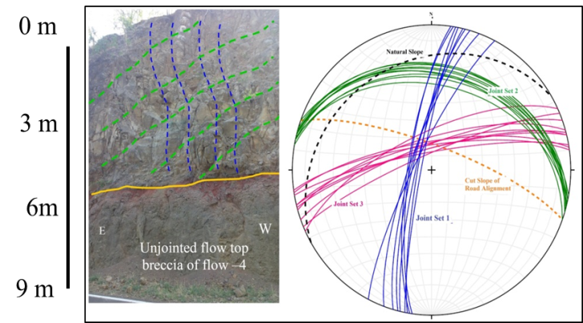
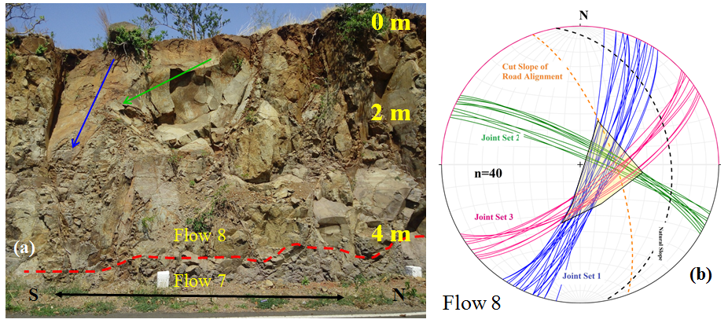
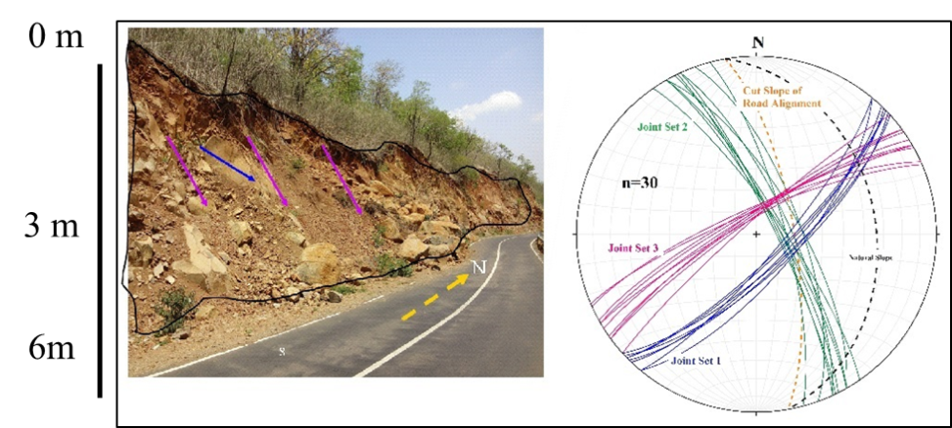
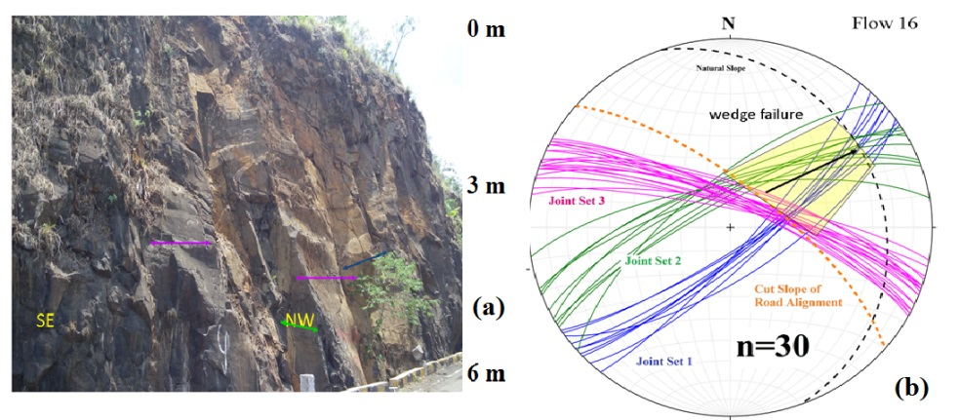
Stereoplot to assess the stability: Sinhagad Ghat
Flow-5, Photo (a) and stereoplot (b)
Flow-8, Photo (a) and stereoplot (b)
Flow-9, Photo (a) and stereoplot (b)
Flow-16, Photo (a) and stereoplot (b)

Slide 24
Case Study-II Dive Ghat

Slide 25
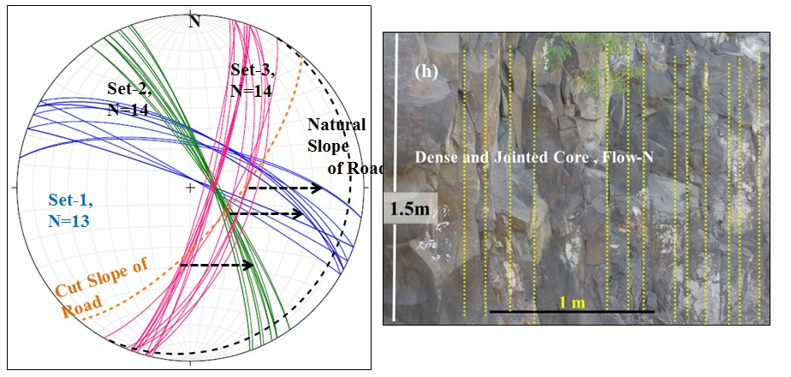
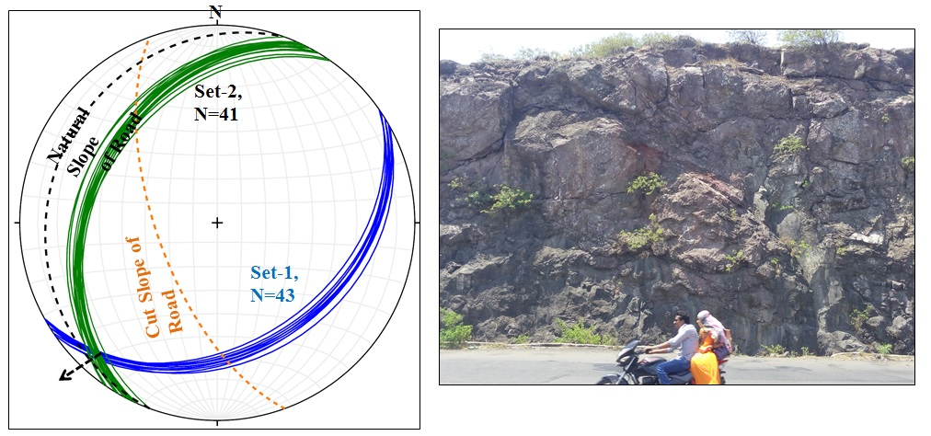
Flow-N, stereoplot (b) and Photo (a)
Flow-M, stereoplot (b) and Photo (a)

Slide 26
Case Study-II Khambataki Ghat

Slide 27
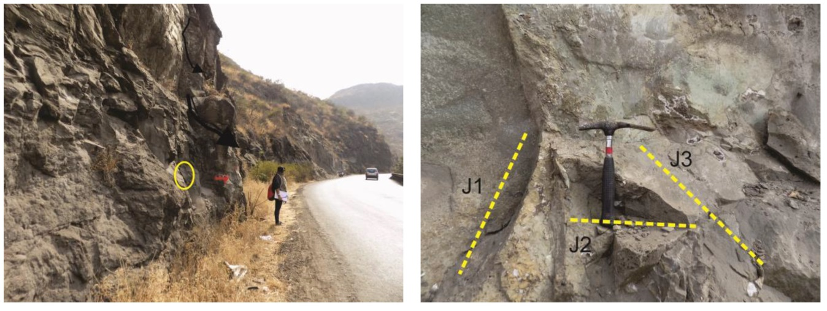
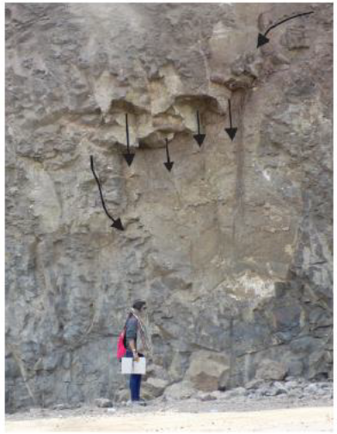
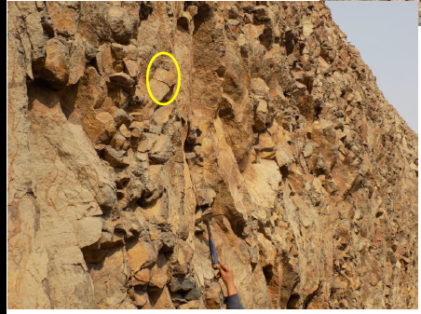
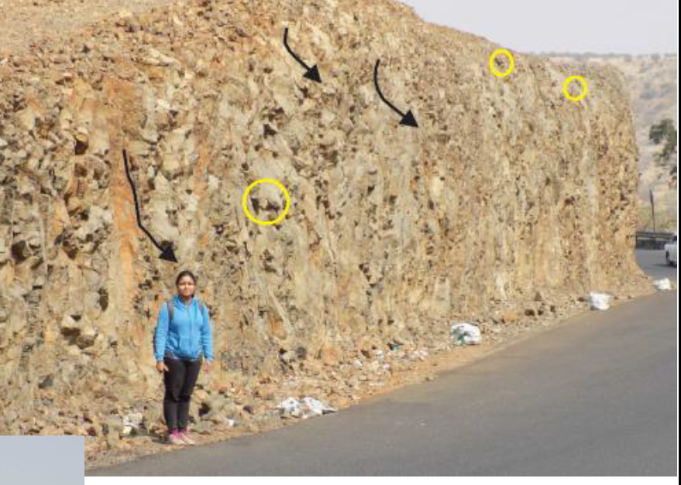
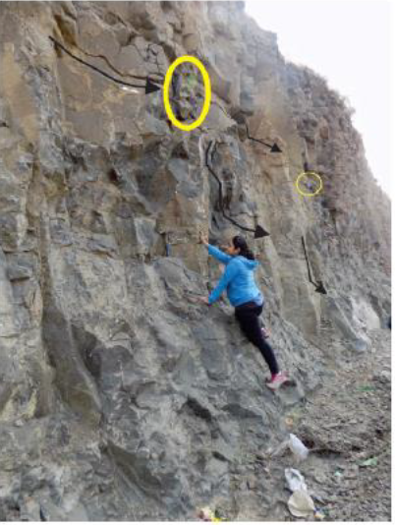
Photo for Flow-6, Khambataki Ghat
Photo for Flow-4, Khambataki Ghat

Slide 28
Conclusions
Slopes developed due to Fragmented top (FT) and fragmented bottom (FB) are relatively gentle as compared to dense and jointed core. Flow-6, 15 from Sinhagad ghat,
The dense core with curviplanar joints occurring either parallel or oblique in orientation to the cut slope is responsible to develop failure planes (All flows from these ghat sections).
Intersection of a curviplanar joint with the road slope develops failure planes e.g. Sinhagad Ghat Flow no. 5, 8, 17, Khambataki Flow 5 and 6, Dive Ghat L, M and N

Slide 29
In short
Aa flows show large variation in thickness proportion of different zones
Similar in appearance /composition, significant change in engineering properties and in situ conditions is observed.
Nature of joints within individual zones are different in aa flow and their networking and orientation governs the slope stability of cut and natural slopes.
Flow morphology, internal architecture, within the flows , rock types, networking of joints, in situ conditions are important aspects that need consideration in infrastructure projects as extension of codes.
The methodology evolved during the work will guide geological investigation slopes in the Deccan Trap region in future.

Slide 30
Agashe, L.Y., Gupte, R.B., (1968). Some significant features of the Deccan Trap. Mem. Geol. Soc. Ind. 2, 309–319
Agashe, L.Y., Gupte, R.B., (1972). Mode of eruption of the Deccan Trap basalts. Bull. Volcanol. 35, 591–601.
Bondre N R, Duraiswami R A and Dole G (2004) Morphology and emplacement of flows from the Deccan Volcanic and emplacement of flows from the Deccan Volcanic Province, India; Bull. Volcanol. 66 29–45
Bondre N R, Duraiswami R A, Dole G, Phadnis V M and Kale V S (2000) Inflated pahoehoe lavas from the Sangamner area of the western Deccan Volcanic Province; Current Science 78 1004–1007
Brown, R.J., Blake, S., Bondre, N.R., Phadnis, V.M., Self, S., (2011). Aa lava flows in Deccan Volcanic Province, India and their significance for the nature of continental flood basalt eruptions. Bulletin of Volcanology 73 (6), 737–752.
Duraiswami, R.A., Bondre, N.R., Dole, G., Phadnis, V.M., (2002). Morphology and structure of Flow-lobe tumuli from the western Deccan Volcanic Province, India. J. Geol. Soc. India 60, 57-65
Duraiswami R A, Dole G and Bondre N R (2003) Slabby pahoehoe from the western Deccan Volcanic Province: evidence for incipient pahoehoe-aa transitions; J. Volcanol. Geotherm. Res. 121 195–217
Duraiswami RA, Bondre NR, Managave S (2008) Morphology of rubbly pāhoehoe (simple) flows from the Deccan Volcanic Province: implications for style of emplacement. J Volcanol Geotherm Res 177:822–836
Duraiswami, R.A., Gadpallu, P., Shaikh, T.N., Cardin, N., (2014). Pahoehoe-‘a’ā transitions in the lava flow fields of the western Deccan Traps, India — implications for emplacement dynamics, flood basalt architecture and volcanic stratigraphy. In: Sheth, H.C., Vanderkluysen, L. (Eds.), Flood Basalts of Asia. J. Asian Earth Sci 84, pp. 146–166.
Gupte R. B., Godbole L. G. (1980): PWD Handbook Chapter 6, Preparation of Projects and Engineering Geology, Govt. of Maharashtra, India, pp. 201-205
Hoek E. & Bray J. (1981), Rock Slope Engineering, (3rded), Institution of Mining and Metallurgy, London, pp. 37 -62 and 150-224.
IS: 11315 (1987)”Methods for quantitative description of joints in rock masses, Part- 1 to 10, Bureau of Indian Standards.
Kainthola A, P.K.Singh, A.B.Wasnik and T.N. Singh, (2012), Distinct Element Modeling of Mahabaleshwar Road Cut Hill Slope, Geomaterial, 2:105-113.M.
Kainthola A. Singh P.K. Singh T.N. (2014), Stability investigation of road cut slope in basaltic rockmass, Mahabaleshwar, India, Geoscience Frontiers, online: DOI: 10.1016/j.gsf.2014.03.002
Kainthola A., Dhananjay Verma, Singh T N, Thareja Rahul, (2014), Influence of water content on Geotechnical Properties of Deccan Basalt, Maharashtra, India, Int Res. Journ. of Geology and Mining, Vol :4(4), pp 122-132, Online: DOI: 10.14303/irjgm.2014.024
Kamarkar B M (1978) The Deccan Trap basalt flows of the Bor Ghat section of the Central Railway. J Geol Soc India 19:106–114
Kamarkar B M (2015), Why rockfalls occur? (Article in Marathi), Daily Sakal, August, 02, 2015.
Krishnamurthy K. V. and S. Majumdar (1973): Geology of Deccan Trap Flows between Khadakvasla and Singh Garh Hiils Poona District, Maharashtra State , Geological Survey of India, Open File Report No. CRO: 104237 (1971 &1972), pp 1-17
Kshirsagar, L.K., 1982. Tuffaceous layers and other clay bearing horizons associated with the Deccan Trap basalts in the region between Pune and Mahabaleshwar, Unpublished PhD Thesis, University of Pune.
Lockwood John P. and Hazlett Richard W. (2010): Volcanoes : Global Perspectives , John Wiley & Sons Ltd, pp 127-172
M. Ahmad, M. K. Ansari & T. N. Singh, (2013), Instability investigations of basaltic soil slopes along SH-72, Maharashtra, India, Geomatics, Natural Hazards and Risk, online: DOI: 10.1080/19475705.2013.826740
M.K. Ansari, M. Ahmad, Rajesh Singh, T. N. Singh, (2015), Rockfall Hazard Rating System along SH-72: a case study of Poladpur–Mahabaleshwar road (Western India), Maharashtra, India, Geomatics, Natural Hazards and Risk Online: DOI : 10.1080/19475705.2014.1003416.
Macdonald, G.A., (1953). Pahoehoe, A’ā, and block lava. Am. J. Sci., 251: 169-191.
Misri J.L. , S. S. Sivasankaran & Dr. M.S. Bodas (2009), Landslide Inventory along Ghat Roads in Western Maharashtra, Geological Survey of India, Open File Report: CRO-22572, Pp1-63
Nagrajan, R.; Mukherjee, A.; Roy, A. & Khire, M.V. (1998). Temporal remote sensing data and GIS application in rockfall hazard zonation of part of Western Ghat, India. International Journal of Remote Sensing, 19: 573-585
Peshwa V V , Mulay J G, Vivek Kale,(1987), Fracture Zones in the Deccan Traps of Western and Central India: A study based on Remote Sensing Techniques, Journal of the Indian Society of Remote Sensing , Vol-15, No-1, 9-17
Walker GPL (1971) Simple and compound lava flows and flood basalts. Bull Volcanol 35:1–12

Slide 31
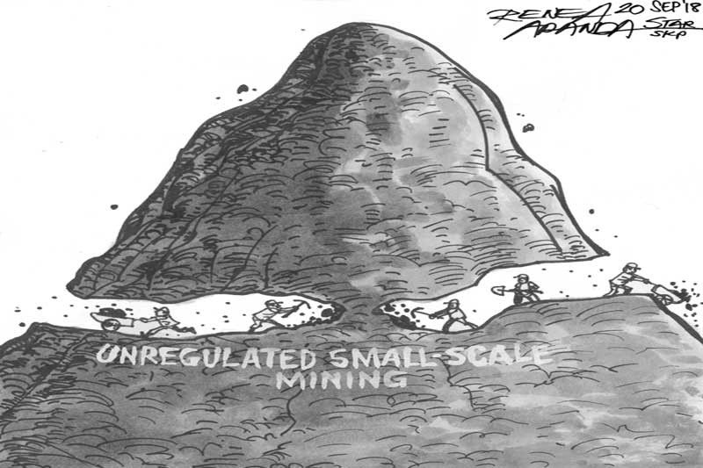
Thank You for patient listening!!!

Slide 32
